Slide 1
Regularizations
Dropout
Call backs
Batch Normalizations
Weight Initializations

Slide 2
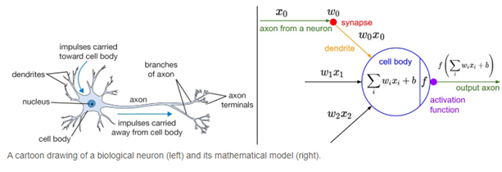

Slide 3
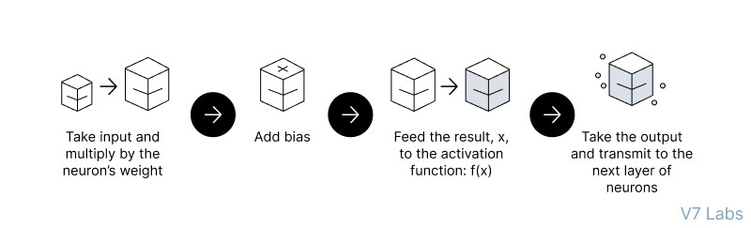
Feedforward Neural Networks (FNN):
the flow of information occurs in the forward direction. The input is used to calculate some intermediate function in the hidden layer, which is then used to calculate an output.
2. Backpropagation
- the weights of the network connections are repeatedly adjusted to minimize the difference between the actual output vector of the net and the desired output vector.
Implement the FNN
https://colab.research.google.com/drive/1z_nL3RcvR1x4uIR88VWEj8Zdr7mYEcQK#scrollTo=keCSdzvOrRmx

Slide 4
Regularizations
https://zilliz.com/learn/understanding-regularization-in-nueral-networks

Slide 5
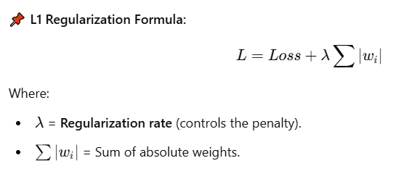
Regularization techniques like L1, L2, and ElasticNet help prevent overfitting by adding a penalty term to the loss function. This keeps model weights small and prevents over-complexity.
1️⃣ L1 Regularization (Lasso Regression)
📖 Definition:
L1 Regularization, also called Lasso (Least Absolute Shrinkage and Selection Operator), adds the absolute values of the weights to the loss function.
✅ Pros:
✔ Encourages sparse models (some weights become zero).
✔ Useful for feature selection (eliminates less important features).
❌ Cons:
❌ Can lead to unstable models when features are correlated.
❌ Not ideal for smooth weight shrinkage.
💻 Code Example (L1 Regularization in TensorFlow/Keras):
from tensorflow.keras.regularizers import l1
model.add(Dense(64, activation='relu', kernel_regularizer=l1(0.01))) # L1 penalty with lambda=0.01

Slide 6
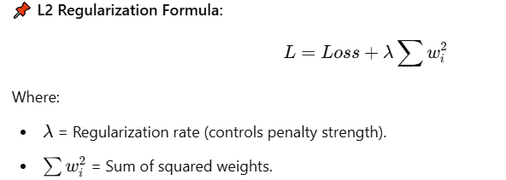
2. L2 Regularization (Ridge Regression)
📖 Definition:
L2 Regularization, also called Ridge Regression, adds the squared values of the weights to the loss function.
✅ Pros:
✔ Encourages smaller weights, preventing overfitting.
✔ Works well when features are correlated.
❌ Cons:
❌ Does not produce sparse models (all weights remain nonzero).
❌ May not be ideal for feature selection.
💻 Code Example (L2 Regularization in TensorFlow/Keras):
python
CopyEdit
from tensorflow.keras.regularizers import l2 model.add(Dense(64, activation='relu', kernel_regularizer=l2(0.01))) # L2 penalty with lambda=0.01

Slide 7
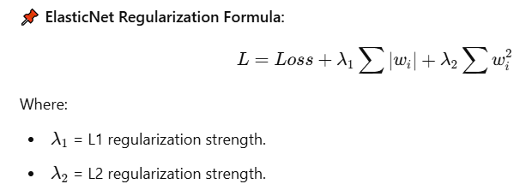
3. ElasticNet Regularization (Combination of L1 & L2)
📖 Definition:
ElasticNet is a hybrid of L1 and L2 regularization. It balances sparsity and smooth weight shrinkage.
📌 ElasticNet Regularization Formula:
✅ Pros:
✔ Provides the best of both L1 and L2.
✔ Works well when features are highly correlated.
❌ Cons:
❌ Requires tuning of both λ1 and λ2​.
💻 Code Example (ElasticNet in TensorFlow/Keras):
python
CopyEdit
from tensorflow.keras.regularizers import l1_l2 model.add(Dense(64, activation='relu', kernel_regularizer=l1_l2(l1=0.01, l2=0.01)))

Slide 8
📌 Regularization Rate (Lambda, λ)
The regularization rateλ\lambdaλ controls how much penalty is applied to large weights:
Low λ → Less penalty (model can overfit).
High λ → More penalty (model can underfit).
Optimal λ → Found using hyperparameter tuning.
📌 Which One Should You Use?
If you want feature selection → L1 (Lasso).
If you want smooth weight shrinkage → L2 (Ridge).
If your data has correlated features → ElasticNet.

Slide 9
Why Use Absolute Value in L1 (Lasso)?
L1 Regularization adds the sum of the absolute values of weights to the loss function:
L=Loss+λ∑∣wi∣i​∣
📌 Key Properties of Absolute Value |w|:
The derivative of |w| is constant (except at zero):
If w>0w > 0w>0, derivative = +1+1+1.
If w<0w < 0w<0, derivative = −1-1−1.
If w=0w = 0w=0, derivative is undefined, but typically set to 0.
📌 Effect on Weights:
L1 applies equal pressure on all nonzero weights, regardless of size.
This forces some weights to become exactly zero, leading to feature selection (sparse models).
💡 Intuition: Imagine you want to shrink some weights to zero while allowing others to stay significant. The absolute value enforces this by applying a constant force that drives small weights to exactly zero.
🔍 Example Weight Update (Gradient Descent in L1):
If a weight is positive, it gets decreased.
If a weight is negative, it gets increased.
If a weight is small, it is forced to zero (sparse model).

Slide 10
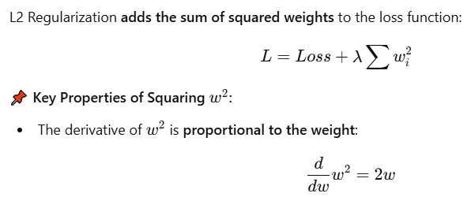
2 Why Use Squaring in L2 (Ridge)?
This means larger weights shrink faster, while smaller weights shrink more slowly.
📌 Effect on Weights:
L2 applies larger penalties to bigger weights, making the weight distribution smooth.
Unlike L1, L2 does not force weights to exactly zero, but shrinks them uniformly.
💡 Intuition: Think of squaring as a way to smoothly reduce large values rather than setting some to zero. It is like a spring that pulls weights back towards zero in a continuous way.
🔍 Example Weight Update (Gradient Descent in L2):
If a weight is large, the gradient (2w) is big, so it shrinks quickly.
If a weight is small, the gradient (2w) is small, so it shrinks slowly.
Why L1 Uses ∣w∣|w|∣w∣ and L2 Uses w2w^2w2?
| Property | L1 Regularization (|w|) | L2 Regularization (w^2) | |-----------|----------------|----------------| | Penalty Type | Absolute value | Squared value | | Effect on Weights | Some weights shrink to zero (sparse) | Weights shrink smoothly (small, but nonzero) | | Best For | Feature selection (removes unnecessary weights) | Preventing overfitting (reduces large weights) | | Weight Shrinkage | Equal shrinkage for all weights | Proportional shrinkage (larger weights shrink more) |
4️⃣ Why Not Swap Them?
If we used L1 with squared values, it wouldn't create sparsity (zero weights).
If we used L2 with absolute values, the gradient wouldn't smoothly reduce large weights.
The current setup is mathematically optimal for their respective goals.

Slide 11
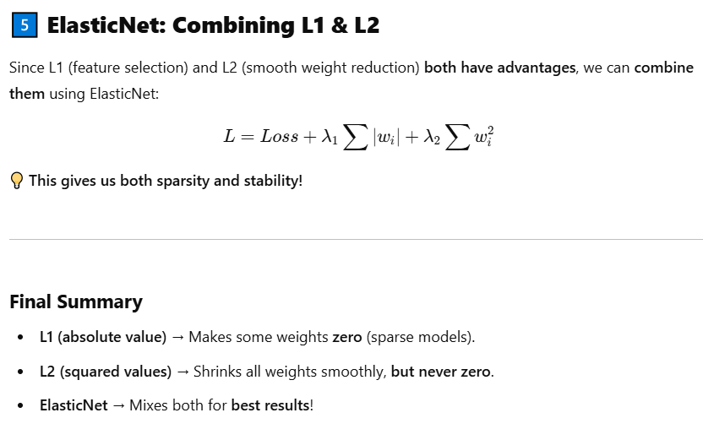

Slide 12
https://www.kaggle.com/code/sid321axn/regularization-techniques-in-deep-learning
https://www.pinecone.io/learn/regularization-in-neural-networks/
https://www.analyticsvidhya.com/blog/2018/04/fundamentals-deep-learning-regularization-techniques/#h-l2-amp-l1-regularization
https://www.geeksforgeeks.org/regularization-in-machine-learning/

Slide 13
Dropout

Slide 14
Call backs
Model Checkpoint
Early stoping

Slide 15
Batch Normalizations

Slide 16
Weight Initializations
Xavier/Glorat And He Weight Initialization in Deep Learning
Exponentially Weighted Moving Average or Exponential Weighted Average

Slide 17
Model Expainlibility
LIME
SHAPY

Slide 18
HyperParameter tuning
keras tunier

